Slide 1
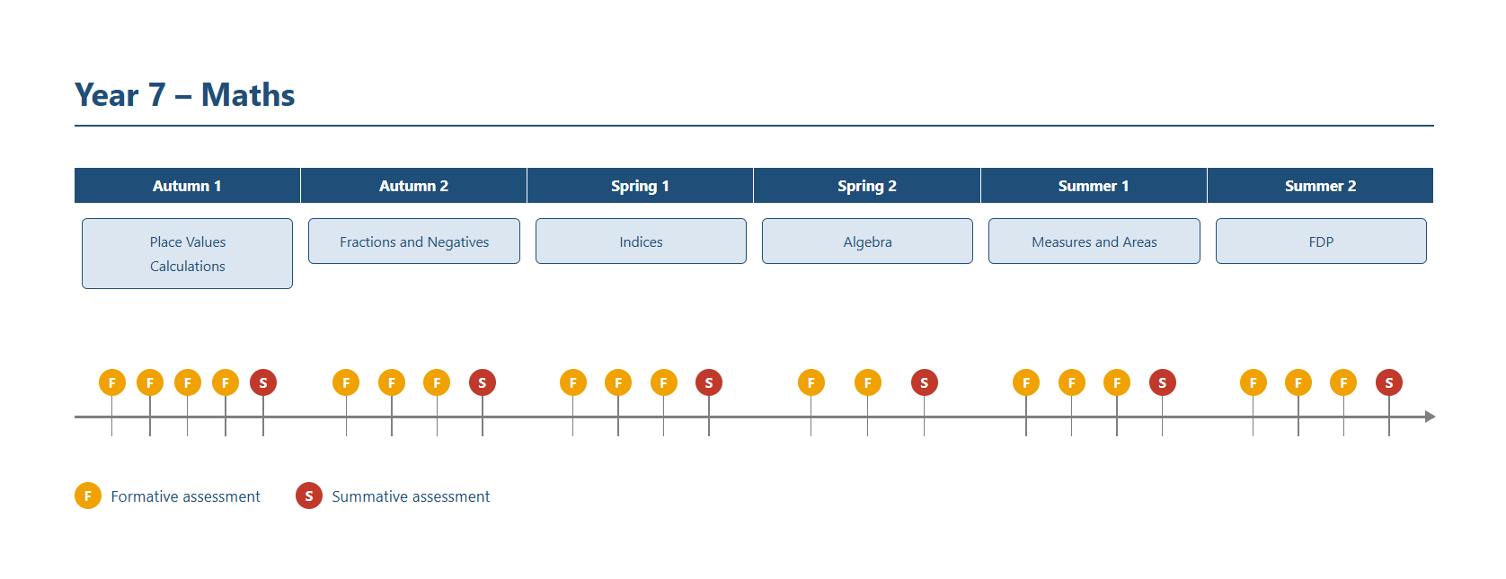
Year 7 – Maths

Slide 2
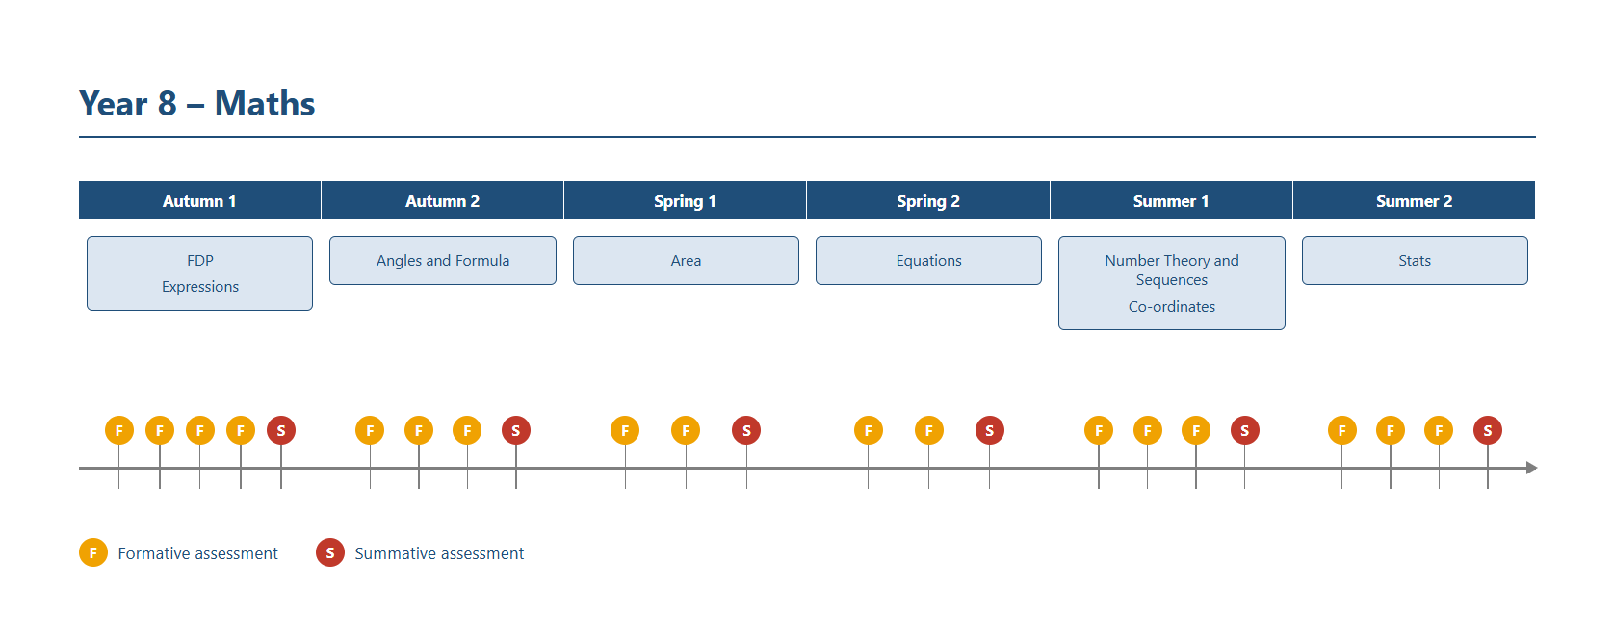
Year 8 – Maths

Slide 3
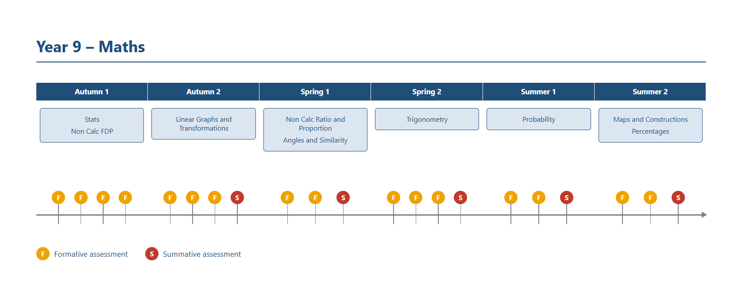
Year 9 – Maths

Slide 4
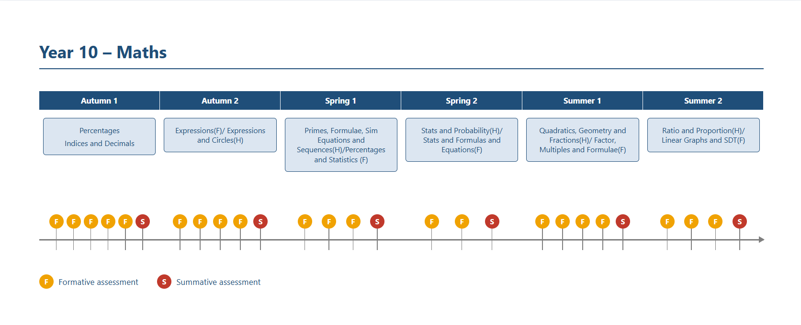
Year 10 – Maths

Slide 5
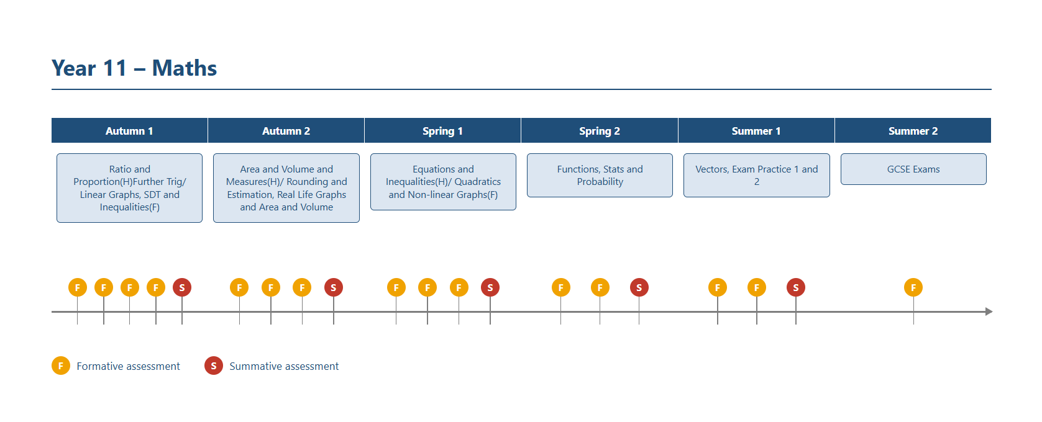
Year 11 – Maths

Slide 6
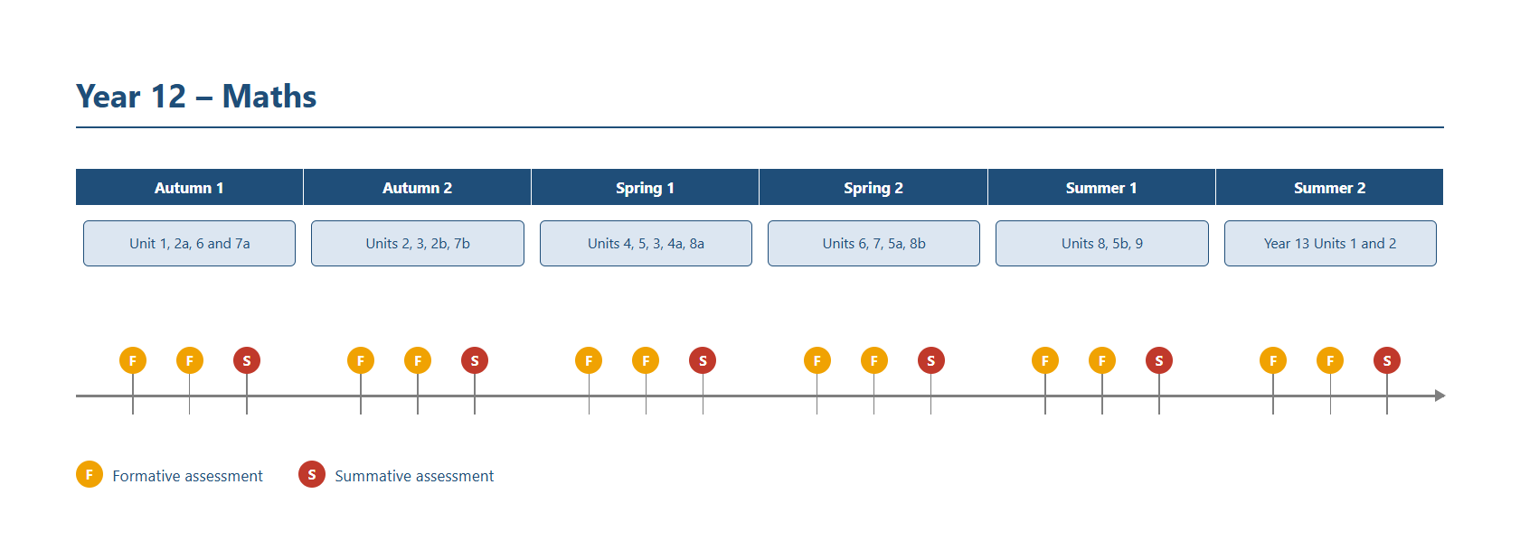
Year 12 – Maths

Slide 7
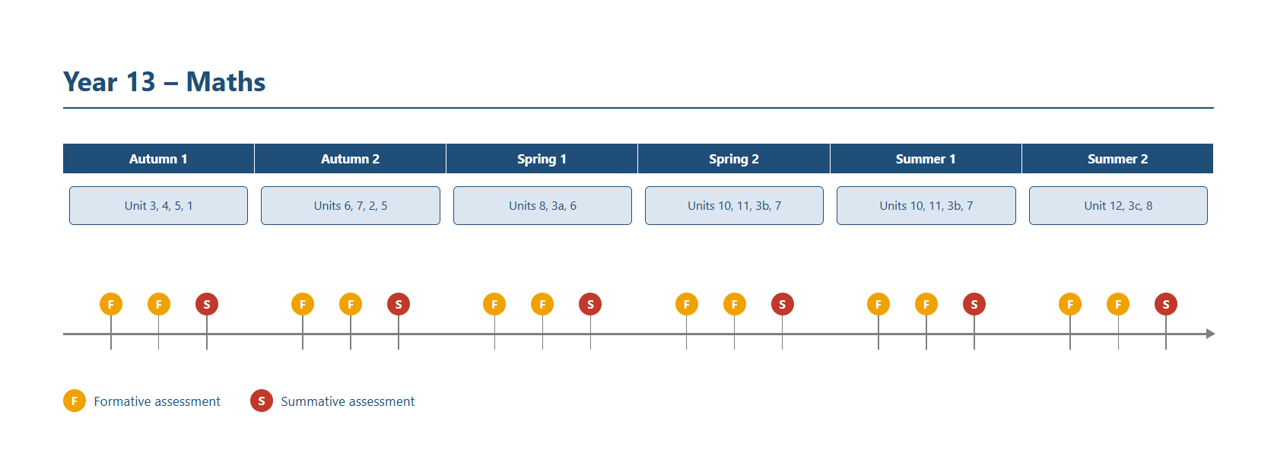
Year 13 – Maths

