Slide 1



Slide 2

The road to success for Year 11

Slide 3
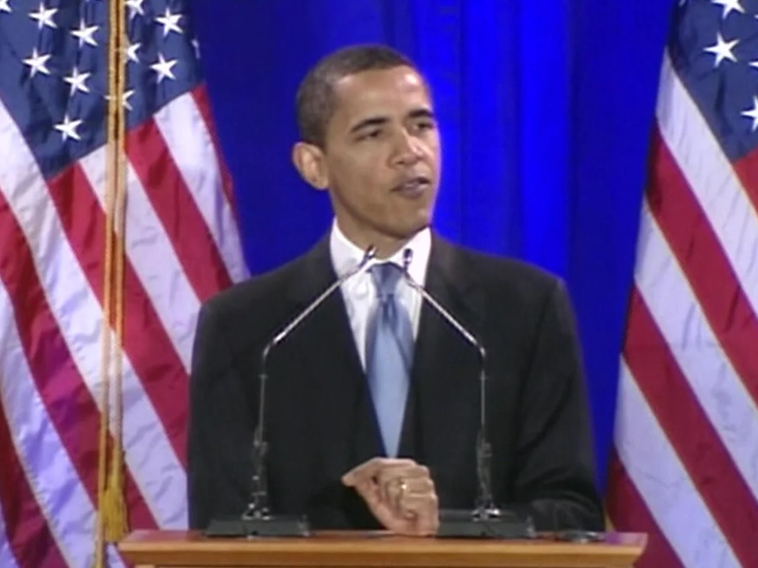


Slide 4
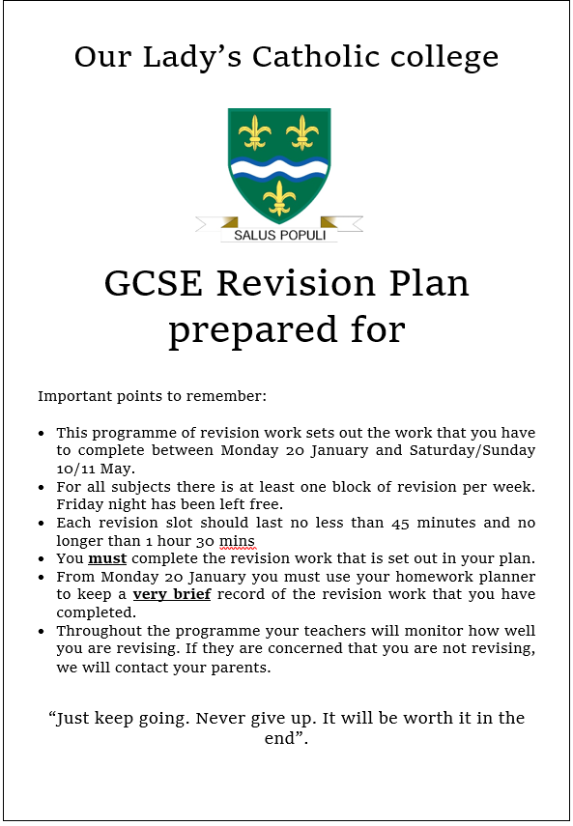


Slide 5
How will our revision plan operate
When does it start ?
12th of January
When will your child use the plan ?
The revision plan will replace traditional homework slots and the revision sessions should take place in these
Why is this plan different?
Each pupil has a plan that is unique to them so they follow revision based on their group of subjects.
Each department formalizes and standradises their plan so that all pupils are given the same resources and are tracked on the revision they are completion
When does it end ?
3rd of May 1 week before the first whole year group exam
How many slots does each subject have ?
You have 2 slots per night each 45 minutes
In a week you will have 2 for English, science and maths and 1 for each of your options and RE
The plan runs from Monday to Thursday with two slots at the weekend
You must complete the revision slots on the night they are set

Slide 6
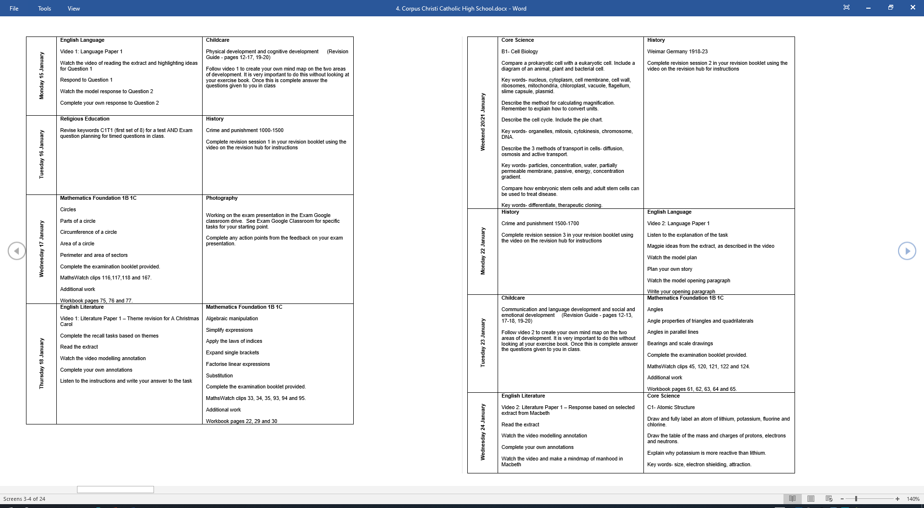

Slide 7
Success is about taking advantage of opportunities

Slide 8
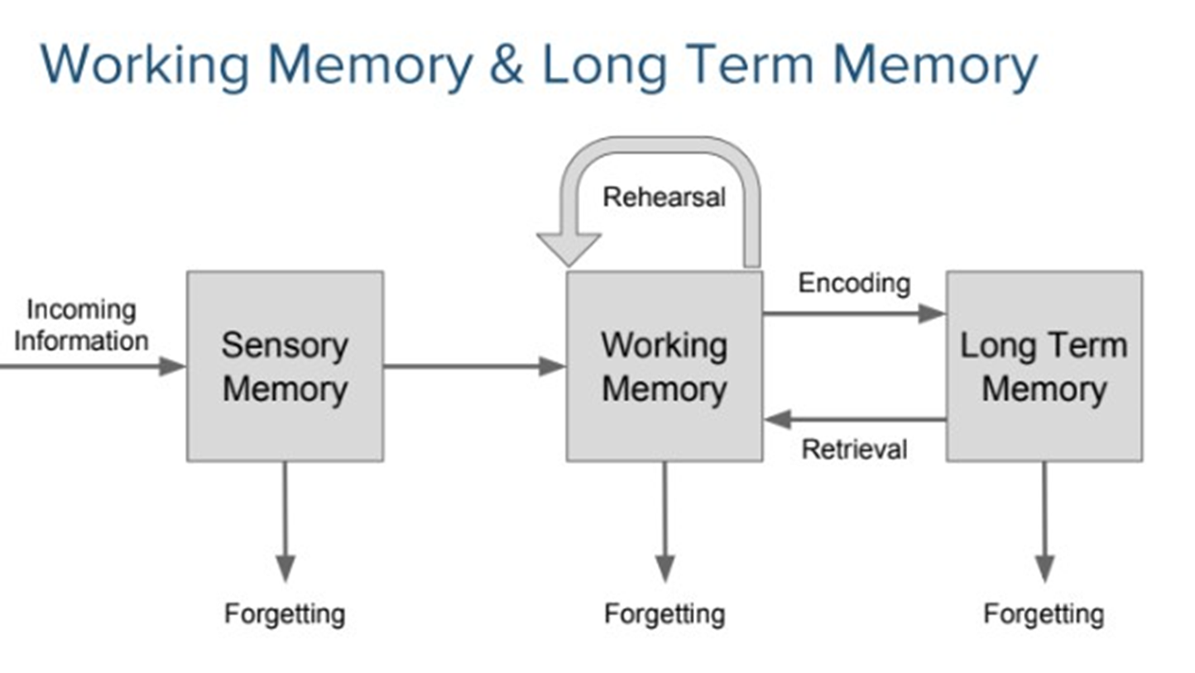

Slide 9
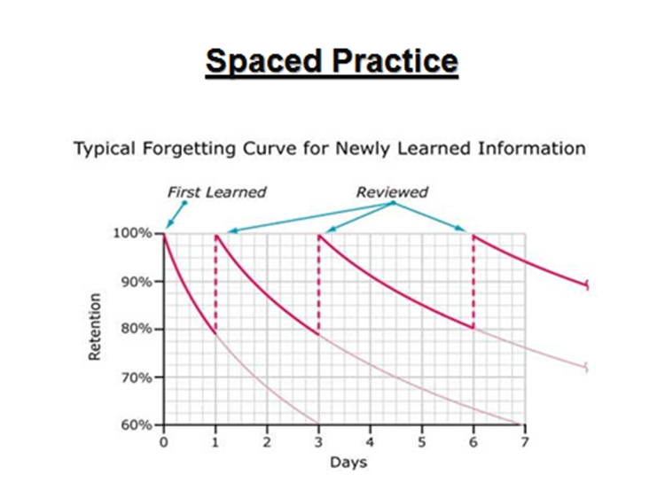
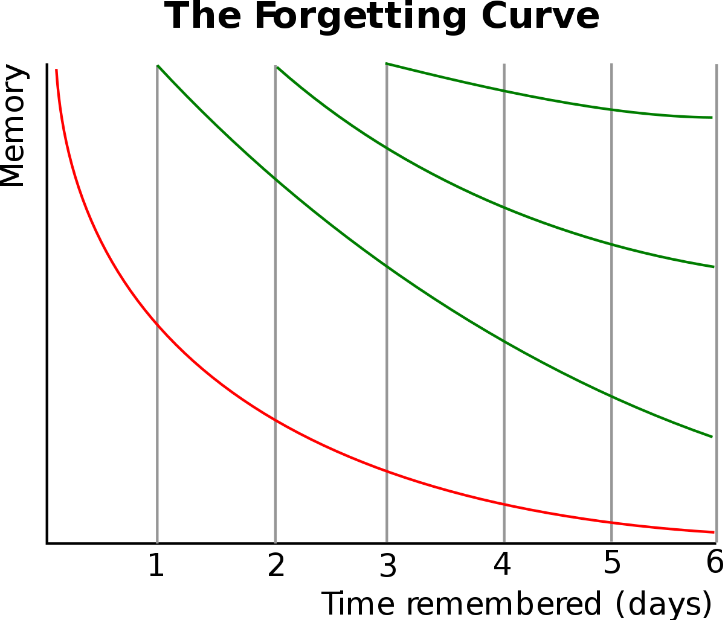

Slide 10




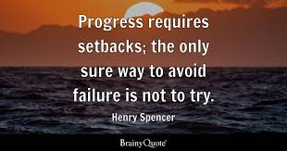


Slide 11

“It meant that I had a clear plan of what revision to do so it was a lot less stressful”
-2025

Slide 12

“My son had a set clear plan of what was needed each day this helped keeping him organised with his revision.”
-2025

Slide 13
“The revision work was pre-set for each day which gave my daughter more of a focus rather than having to rely on her own choice of revision. It gave her a better drive”.
-2025

Slide 14
“If I was to revise myself I wouldn’t have remembered as much as I have”
-2025

Slide 15


Slide 16


3 missed 1 central detention phone call by Mr Hughes
6 missed 2 central detentions meeting with parents in person Mrs Calverley
9 missed 3 central detentions meeting with parents with Mrs Porter
12 missed 4 central detentions meeting with parents with Mr Coyle
15 missed 5 central detentions meeting with parents with Mrs Seddon

Slide 17
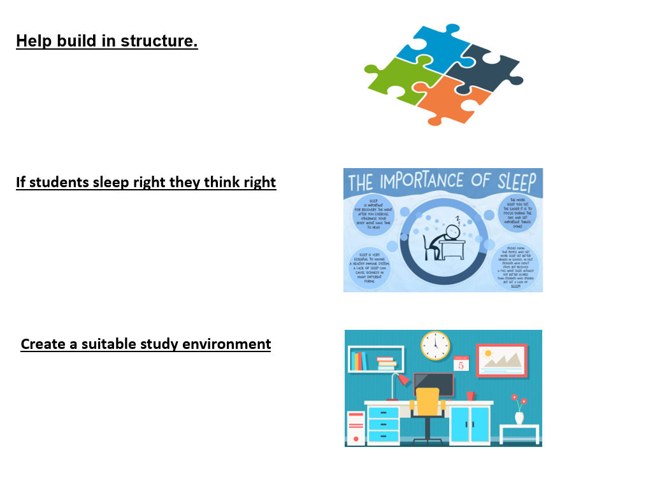

Slide 18
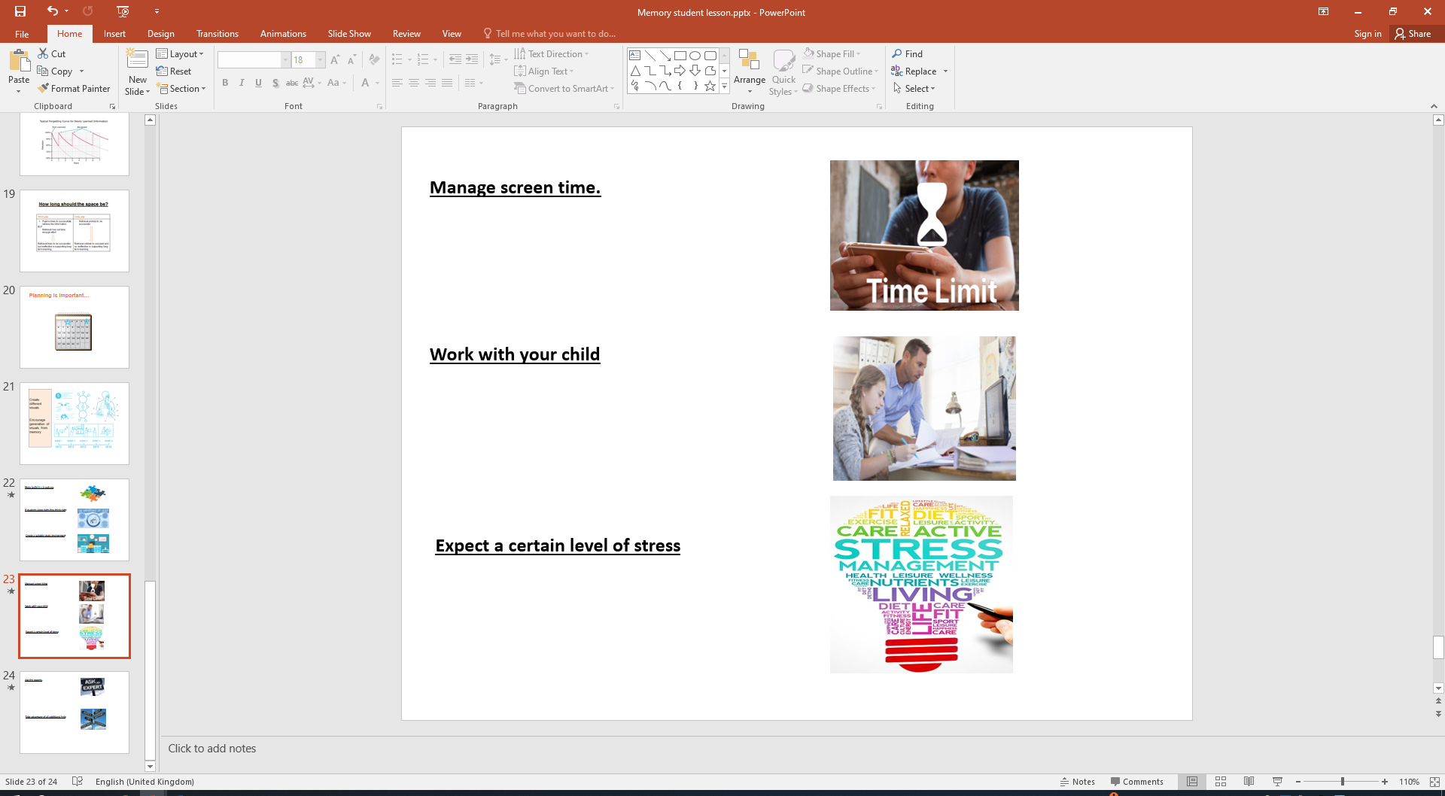

Slide 19

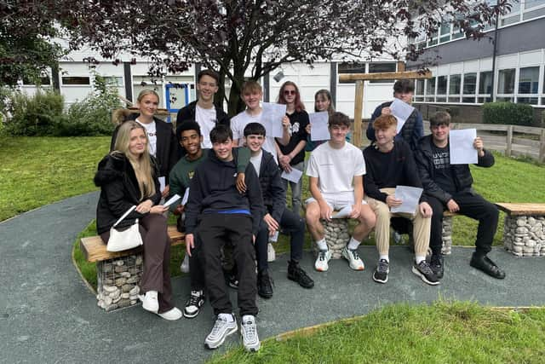



OR

Slide 20

Success is about taking advantage of opportunities
12th January-3rd May

Slide 21

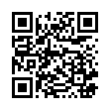
Success is about taking advantage of opportunities

